Slide 1

Chapter 16 – extra

Slide 2
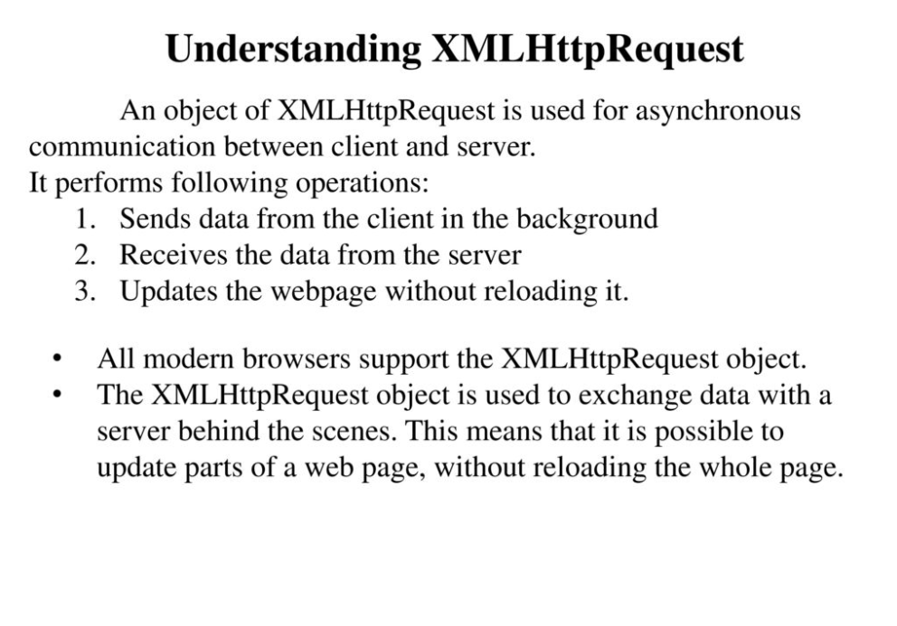
Source: https://slideplayer.com/slide/12988549/

Slide 3
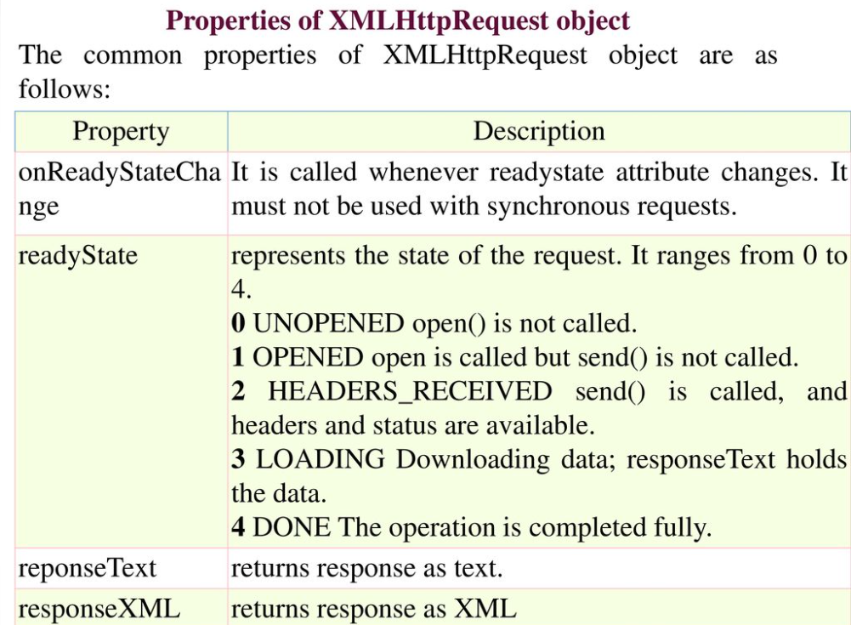

Slide 4
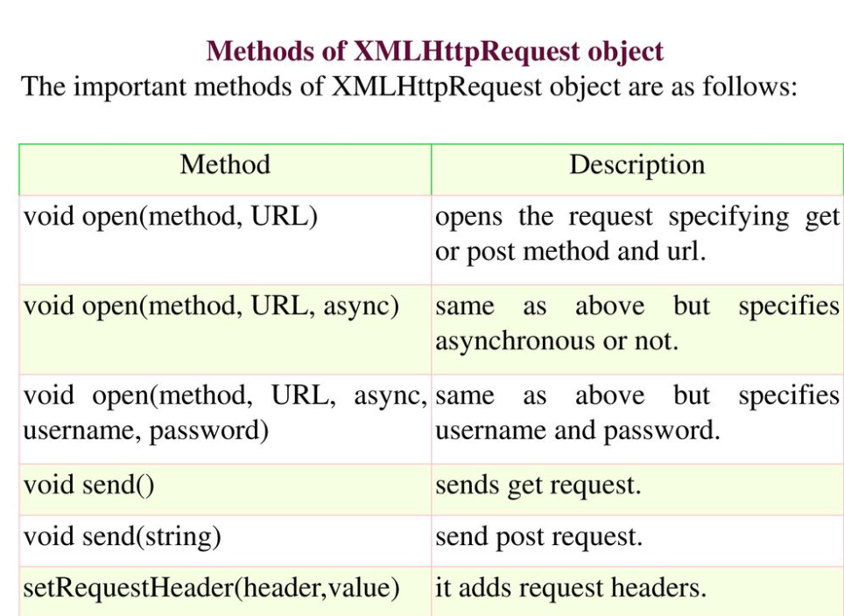

Slide 5
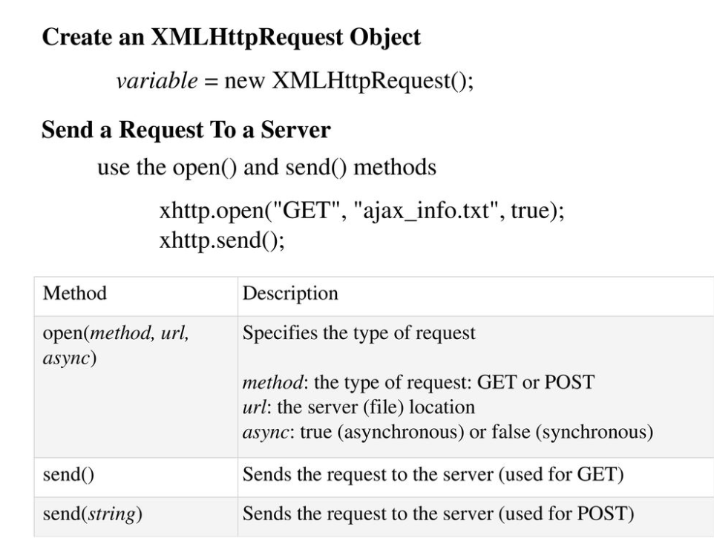

Slide 6
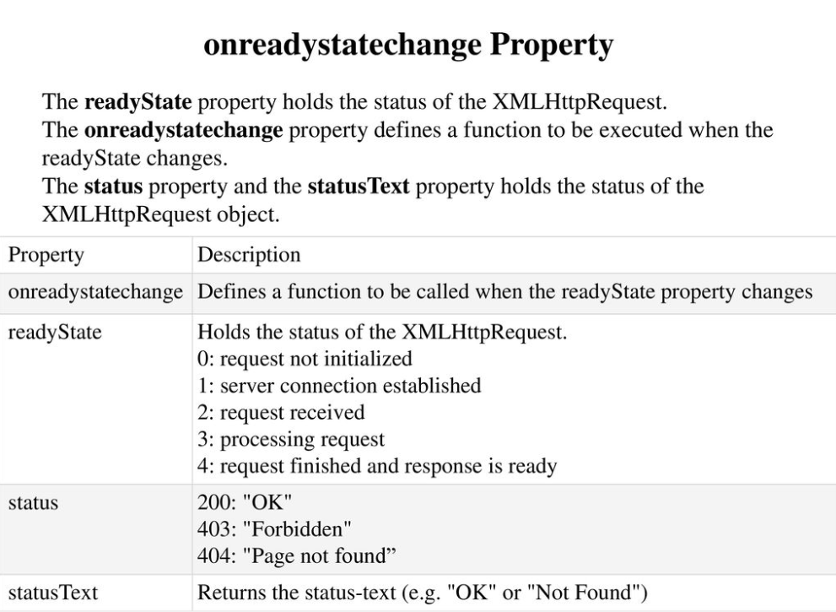

Slide 7
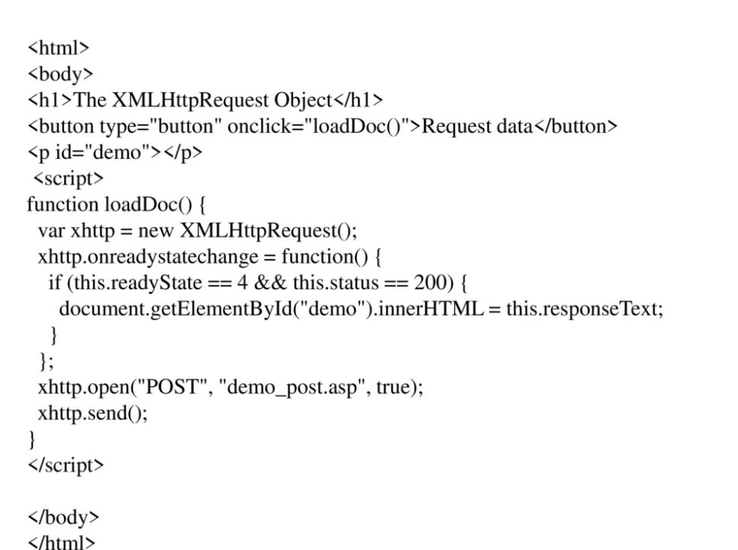


Create a function
Open the request
Check the property for statechange
Place the entire responseText into a variable to parse thru using the parse method
Send the request to the server: Use GET

Slide 8
How to use the parse method with json text string p 527

Slide 9
var http_request;
try {
http_request = new XMLHttpRequest();
} catch (e) {
alert("No response found at this time@");
return false;
}
http_request.open("GET", "JSON FILE LOCATION", false);
http_request.send();
var holdJSONObj = JSON.parse(http_request.responseText);
//do your logic

Slide 10
Update in class project/Colors project
Update current project:
Create two .json files and place in a data folder (name it data).
Move each object to a different file.
Using the XMLHttpRequest, open those files and use the same variable names (comment out the original definition of the variables) for the parsed responseText and make sure your logic still works.
Update Colors: externalize the colors object into a JSON file and
Using the XMLHttpRequest, open the new file and use the same variable name (comment out the original definition of the variables) for the parsed responseText and make sure your logic still works.

Slide 11
XML
XML stands for Extensible Markup Language. It is a text-based markup language derived from Standard Generalized Markup Language (SGML).
XML tags identify the data and are used to store and organize the data, rather than specifying how to display it like HTML tags, which are used to display the data.
There are three important characteristics of XML that make it useful in a variety of systems and solutions:
XML is extensible: XML allows you to create your own self-descriptive tags or language, that suits your application.
XML carries the data, does not present it: XML allows you to store the data irrespective of how it will be presented.
XML is a public standard: XML was developed by an organization called the World Wide Web Consortium (W3C) and is available as an open standard.

Slide 12
XML
XML can work behind the scene to simplify the creation of HTML documents for large web sites.
XML can be used to exchange the information between organizations and systems.
XML can be used for offloading and reloading of databases.
XML can be used to store and arrange the data, which can customize your data handling needs.
XML can easily be merged with style sheets to create almost any desired output.
Virtually, any type of data can be expressed as an XML document.

Slide 13
XML Syntax
<?xml version="1.0"?>
<contact-info>
<name>Jennifer Doe</name>
<company>BCBS</company>
<phone>(011)123-4567</phone>
</contact-info>
You can notice, there are two kinds of information in the above example:
Markup, like <contact-info>
The text, or the character data, BCBS and (011)123-4567

Slide 14
XML Syntax
<?xml version="1.0"?>
<contact-info>
<contact>
<id>z38p</id>
<name>Jennifer Doe</name>
<company>BCBS</company>
<phone>(011)123-4567</phone>
</contact>
<contact>
<id>z38q</id>
<name>Matt MyBoss</name>
<company>MTC</company>
<phone>(011)123-5678</phone>
</contact>
</contact-info>

Slide 15
Syntax Rules for XML Declaration
The XML declaration is case sensitive and must begin with "<?xml>" where "xml" is written in lower-case.
If the document contains XML declaration, then it strictly needs to be the first statement of the XML document.

Slide 16
Syntax for tags and elements (XHTML Rules)
Elements must be container elements or empty.
<element> … </element>
<element/>
Nested elements are last to open, first to close.
Each XML document may only have one root element.
Elements are case sensitive.
<name> … </Name> ← Incorrect Syntax

Slide 17
XML Text
The names of XML-elements and XML-attributes are case-sensitive, which means the name of start and end elements need to be written in the same case. To avoid character encoding problems, all XML files should be saved as Unicode UTF-8 or UTF-16 files.
Whitespace characters like blanks, tabs and line-breaks between XML-elements and between the XML-attributes will be ignored.
Some characters are reserved by the XML syntax itself. Hence, they cannot be used directly. To use them, some replacement-entities are used, which are listed below:
Not Allowed Character Replacement Entity Character Description
< &lt; less than
> &gt; greater than
& &amp; ampersand
' &apos; apostrophe
" &quot; quotation mark

Slide 18
Project: convert json to xml for states
TO DO: Create an xml file in the data directory and using the states format
convert the JSON file to an xml file that we will parse for the next project

Slide 19
ajax and xml
var http_request;
try {
http_request = new XMLHttpRequest();
} catch (e) {
alert("No response found at this time!");
return false;
}
http_request.open("GET", "XML FILE LOCATION", false);
http_request.send();
/// NOPE var holdJSONObj = JSON.parse(http_request.responseText);
var holdXMLObj = http_request.responseXML;
//do your logic

Slide 20
how to parse xml in javascript
Alternate syntax:
const parser = new DOMParser();
const holdXMLObj = parser.parseFromString(xhttp.responseText, "text/xml");
vs
var holdXMLObj = http_request.responseXML;
https://developer.mozilla.org/en-US/docs/Web/API/XMLHttpRequest/responseXML

Slide 21
convert in class project with states to parsed xml
var xhttp = new XMLHttpRequest(); xhttp.onreadystatechange = function() { if (this.readyState == 4 && this.status == 200) { myFunction(this); } }; xhttp.open("GET", "XML FILE", true); xhttp.send(); function myFunction(xml) { var xmlDoc = xml.responseXML; var mainTags = xmlDoc.getElementsByTagName("TAG THAT IS THE MAIN OUTER TAG"); <- ARRAY //LOOP THRU THE NUMBER OF XML GROUPS UNTIL WE RUN OUT
//USING ARRAY NOTATION, GRAB THE OTHER TAGS IN THE GROUP BY NAME
}
https://www.w3schools.com/xml/met_document_getelementsbytagname.asp

Slide 22
Parsing thru xml using child nodes
for (var i = 0; i < mainTags.length; i++) {
xmlDoc.getElementsByTagName("first tag")[i].childNodes[0].nodeValue
//get all of the items using each tag name and write them out
// to the screen as you did with JSON
}
https://developer.mozilla.org/en-US/docs/Web/Guide/Parsing_and_serializing_XML

